Slide 1
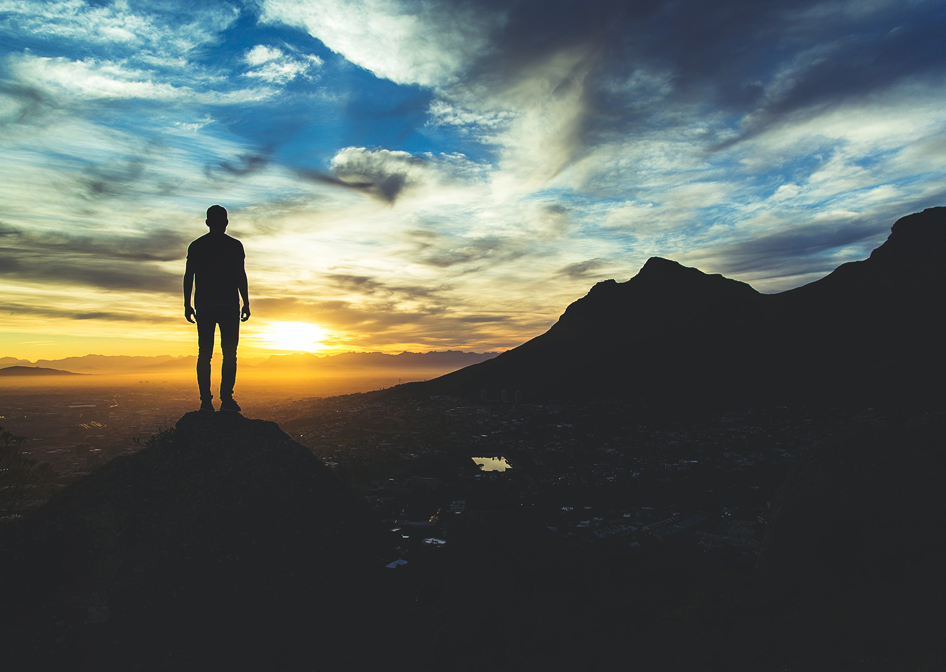
Smarter year
Begin your life journey with personal growth, purpose, and a team to help light your way.
Smarter Year
Personal Insights and Growth
Career exploration and preparation
Teamwork to accomplish goals
and social good projects

Slide 2
Are you preparing for job or your best life?

Slide 3
Begin Your Journey
Gain personal insights of Strengths, Emotional Intelligence And Values.
Clarify your life goals.
Target and Explore Career and training/College options.
Prepare resume, Business Plan, Job Interview and Pitch.
Work with peers to accomplish social good project and accomplish a shared goal.
Build a personal plan and vision board

Slide 4
Inspiration:
Emma Perez
Life Quest
http://www.emmabperez.com/life-quest.htm
What’s the Point of School?

Slide 5
Life Quest involves school counselors to help students think through their values and interests, create vision of their future, choose careers that fit them, and prepare for their next step.

Slide 6
Five Happy Elements
Emotional Health and Positive Relationships
Physical Health and Nutrition
Financial Literacy
Community Involvement and Effective Altruism
Play and Exploration of Interests

Slide 7
Pricing: $1,300 dollars per student?

Slide 8
Smarter Year adds
Mentorship
Teamwork
Peer learning and projects

Slide 9
Building a Smarter Year
Who wants to participate?
How many sessions? How many hours? The start and ending of each cohort?
How many students?
How do we market the program?
How do we pay Mentors?
Ask for Grant or Start Up Money?
What role does BJHSG play?
Which sessions/resources from BJHSG would we integrate into program?
PI Index?
All online or some in person activities?

